Slide 1

ROBOTICS
EV3 MINDSTORMS

Slide 2
-Index-
1- What is robotics
2- Future of robotics
3- Start with Lego Mindstorms EV3 Robot
4- Devices for EV3 Robot-
A- Motor
B- Touch sensor
C- colour sensor
D- Inferred sensor
E- Gyro sensor
5- EV3 robot in IT Lab
6- Build your own robot
7- Program with another language.
8- Introduce to Java leJos
9- Write your first EV3 java program
10- Conclusion

Slide 3
1. What is robotics
Robotics is the branch of technology that deals with the design, construction, operation, and application of robots. Robots are machines that can be used to do jobs. Some robots can do work by themselves. Other robots must always have a person telling them what to do.

Slide 4
2. Future of robotics
There are no doubt, our tomorrow land will be the future of robotics. The rise of the machine will take control most of our global workforce and few smart people controlling them. In our current world. NASA, Aviation industries, Motor industries and so on relies on robots in many different ways. .
Do you like technology? Do you want to take control of your future? Then your future start here!

Slide 5
3. Start with Lego Mindstorms EV3 Robot
The first generation of Lego Mindstorms was built around a brick known as the RCX. Then the NXT version introduced to technology market. Year 2013, Lego introduce us with its latest robotic system, called Lego Mindstorms EV3. The Lego Mindstorms EV3 is the third generation Lego Mindstorms product. EV3 is a further development of the NXT. The LEGO MINDSTORMS EV3 set includes motors, Touch sensors, Colour sensor, Infrared sensor, Gyro sensor, the EV3 programmable brick, and a remote control. The EV3 can be controlled by smart-devices (your smart phone).

Slide 6
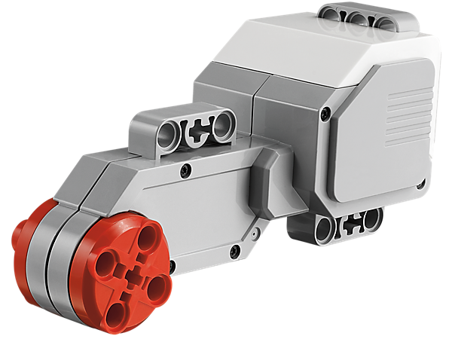
4. Devices for EV3 Robot--
(a) Motor- EV3 Servo Motor is a powerful motor that has a precise control to within one degree of accuracy rotation. By using the built-in rotation sensor, the intelligent motor can be made to align with other motors on the robot so that it can drive in a straight line at the same speed. It can also be used to give an accurate reading for experiments. The motor case design also makes it easy to assemble gear trains.

Slide 7
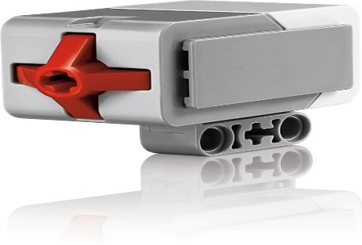
(b) Touch Sensor- EV3 Touch Sensor is a simple but exceptionally precise tool that detects when its front button is pressed or released and is able to count single and multiple presses. Students can build start/stop control systems using this button.

Slide 8
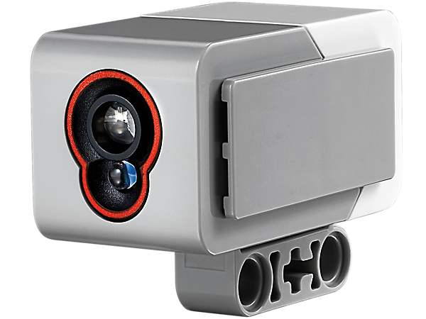
(c) Colour sensor- The digital EV3 Colour Sensor distinguishes between eight different colours. It also serves as a light sensor by detecting light intensities. Students can build colour sorting and line-following robots using this sensor

Slide 9
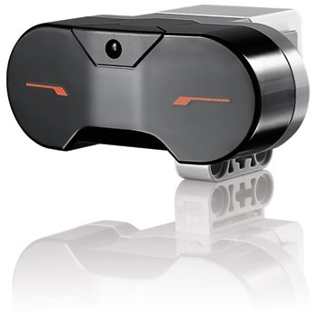
(d) Infra-red sensor- EV3 Infra-red Sensor detects distance and reads signals emitted by the EV3 Infra-red Beacon. Students can create remotely-controlled robots, navigate obstacle courses and learn how infra-red technology is used in TV remotes, surveillance systems and even in target acquisition equipment.

Slide 10
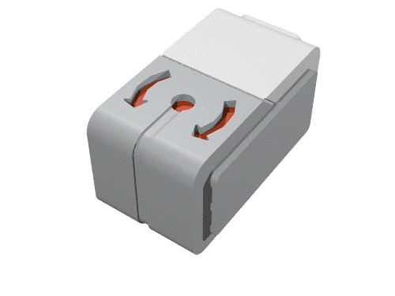
(e) Gyro sensor- EV3 Gyro Sensor measures the robot’s rotational motion and changes in its orientation. Students can measure angles, create balancing robots and explore the technology that powers a variety of real-world tools like Seaway.

Slide 11
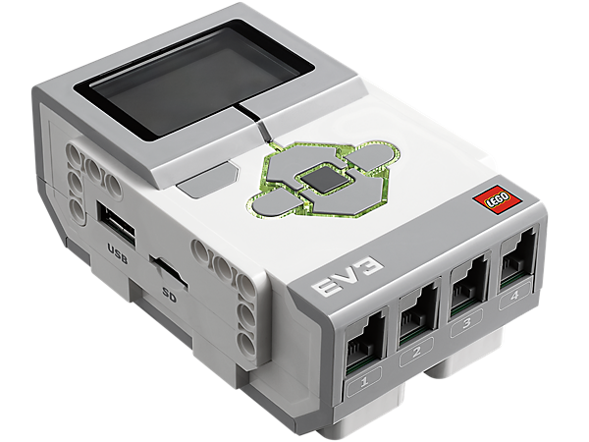
(f) EV3 Bricks- This programmable, intelligent brick serves as the heart and brain of Mindstorms EV3 robots. ***This programmable, intelligent brick serves as the heart and brain of LEGO MINDSTORMS Education EV3 robots.

Slide 12
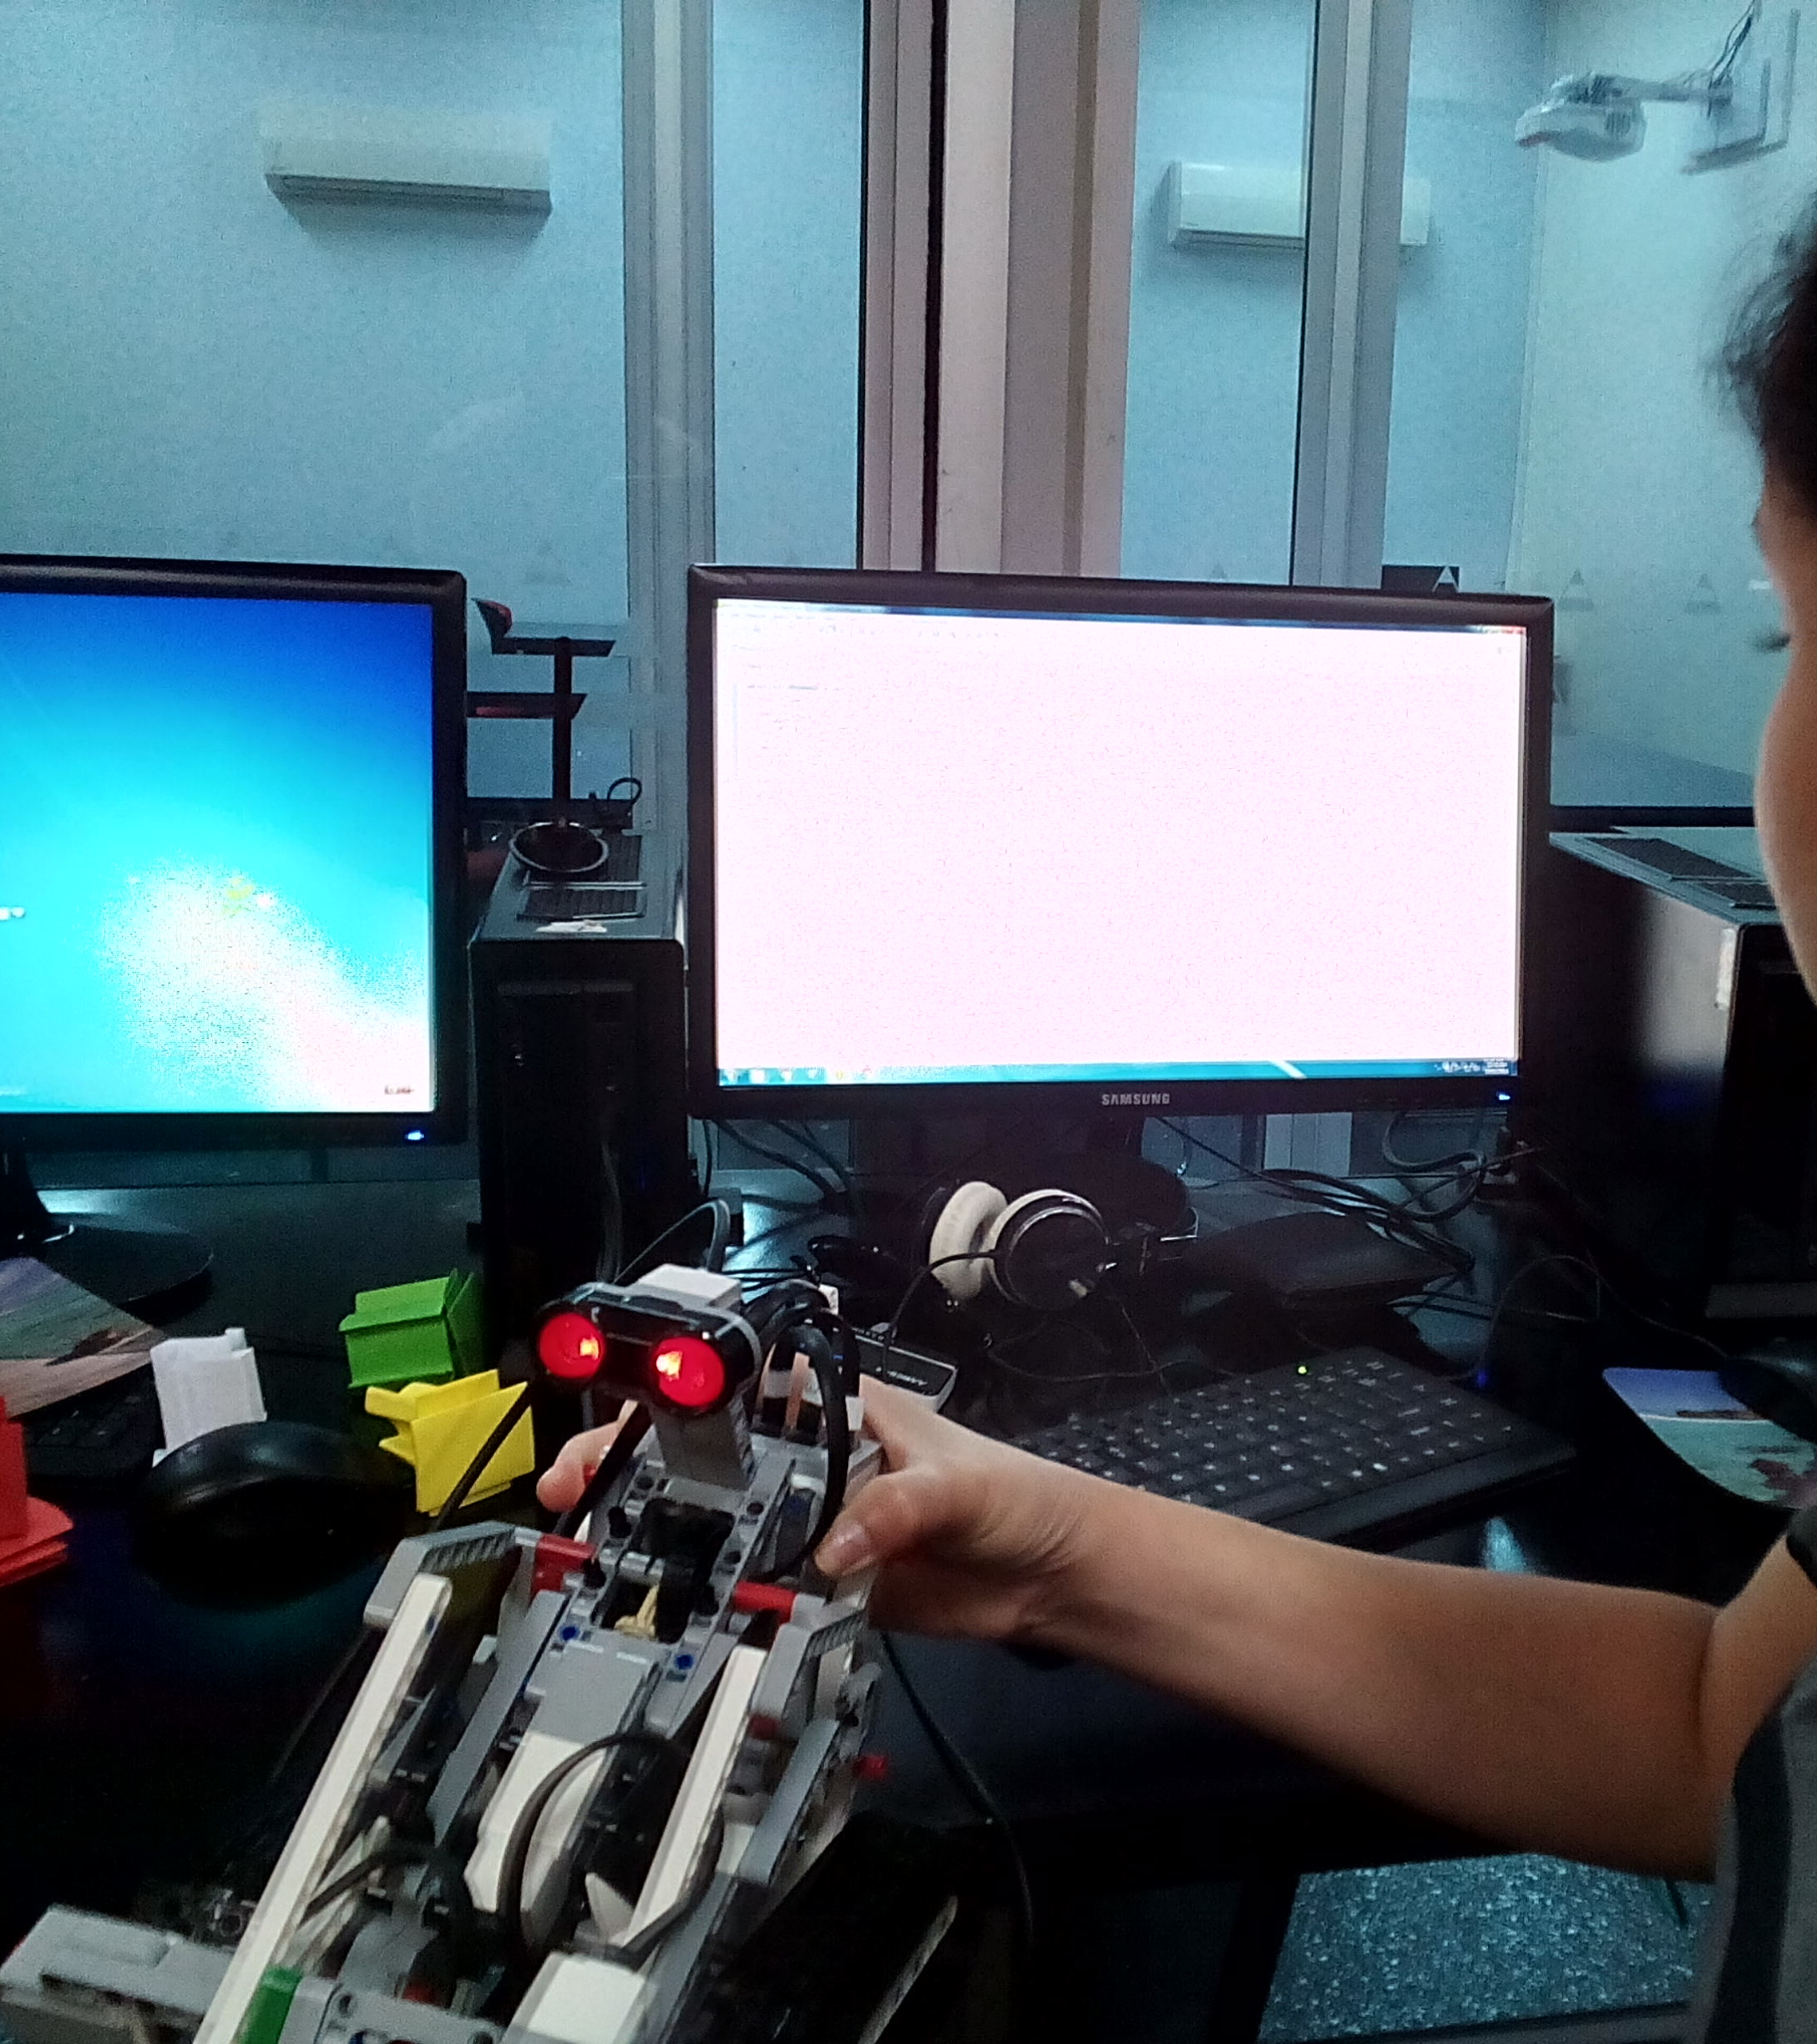
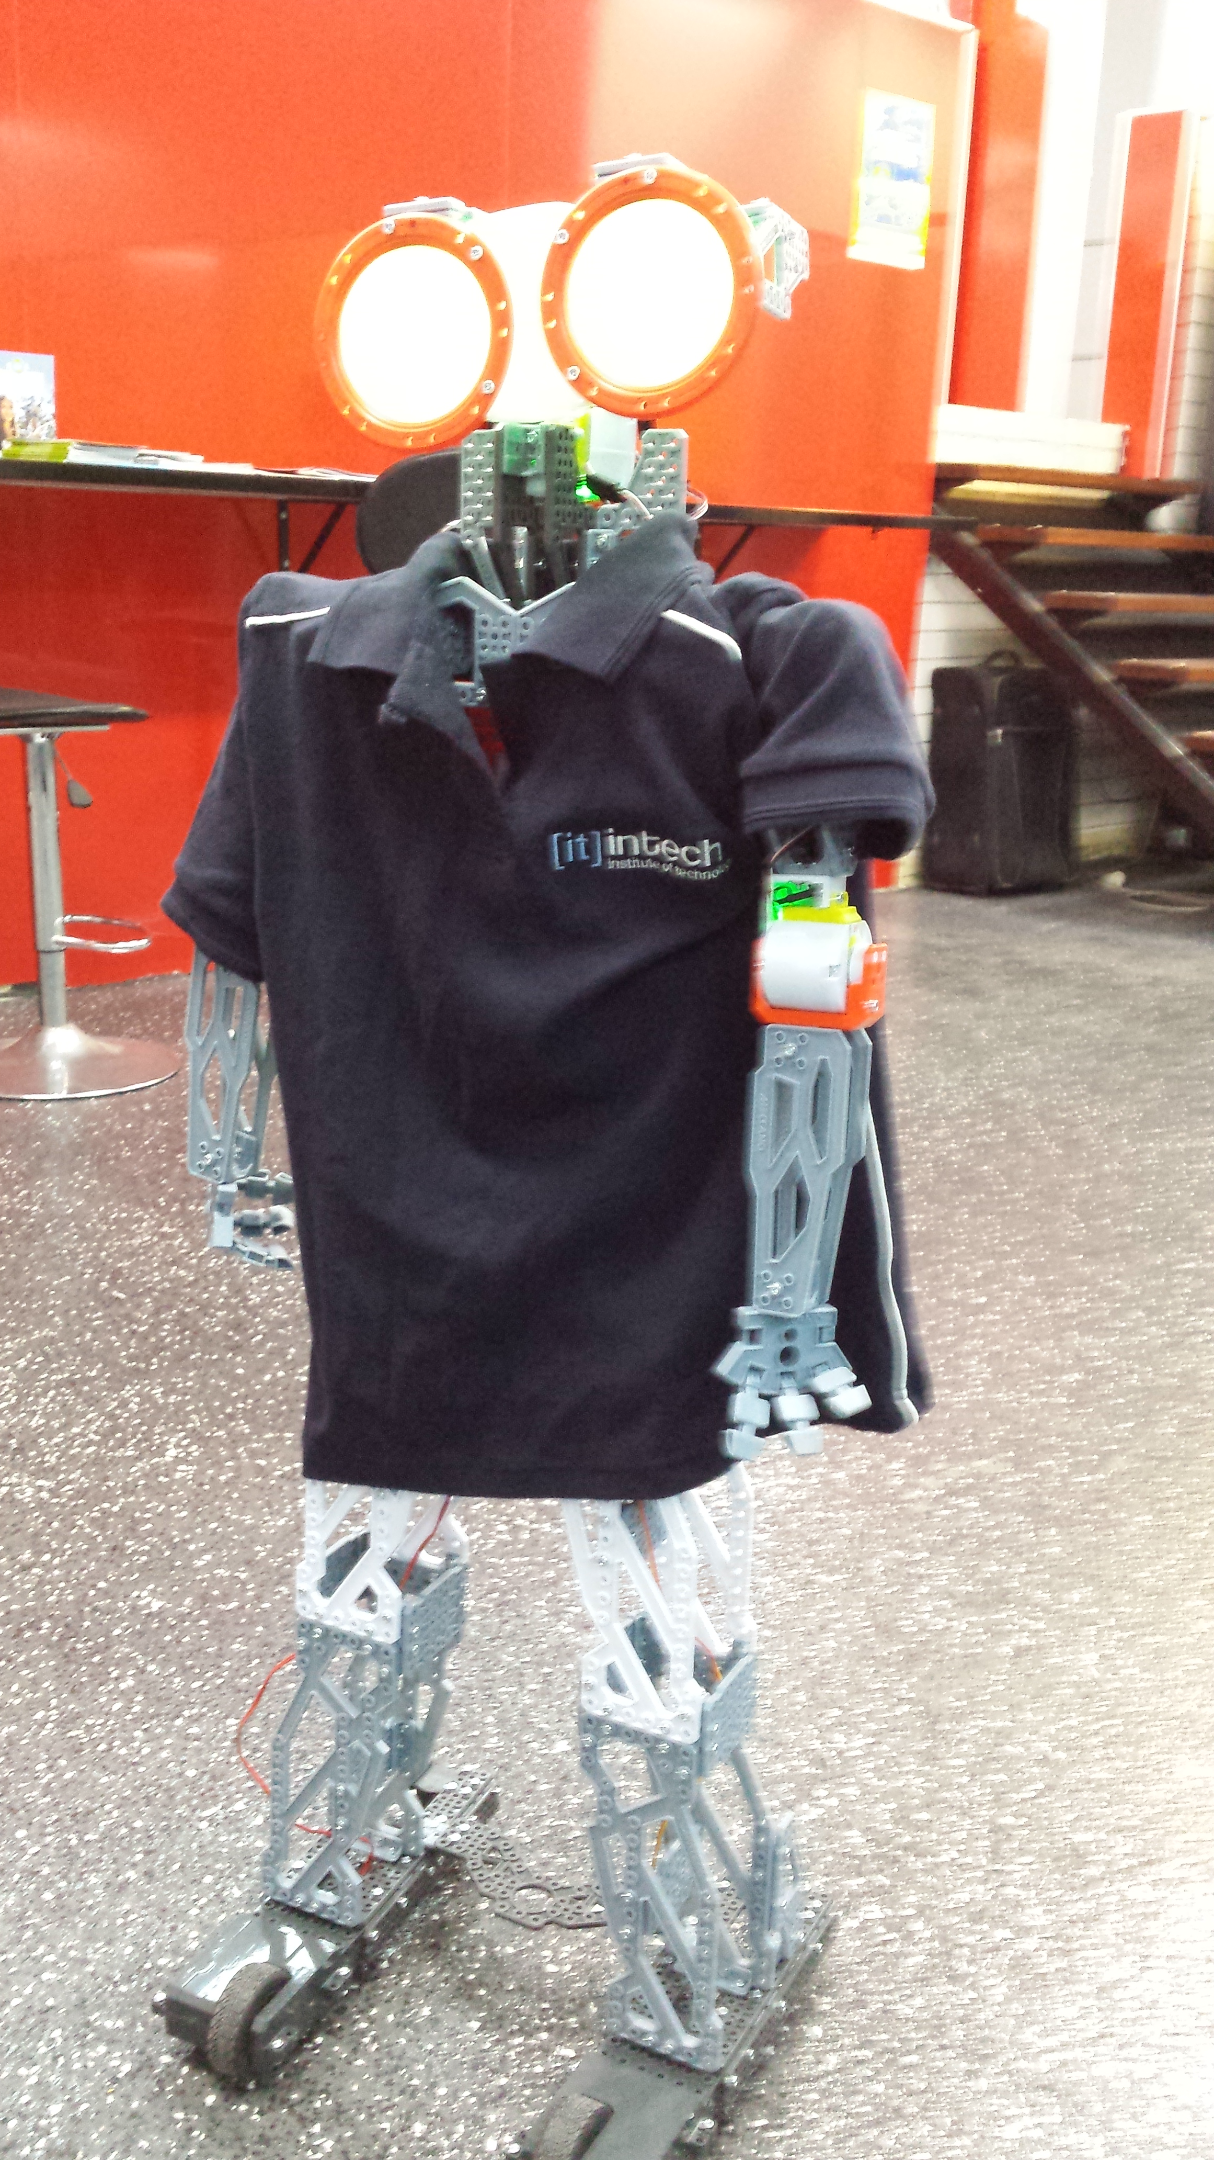
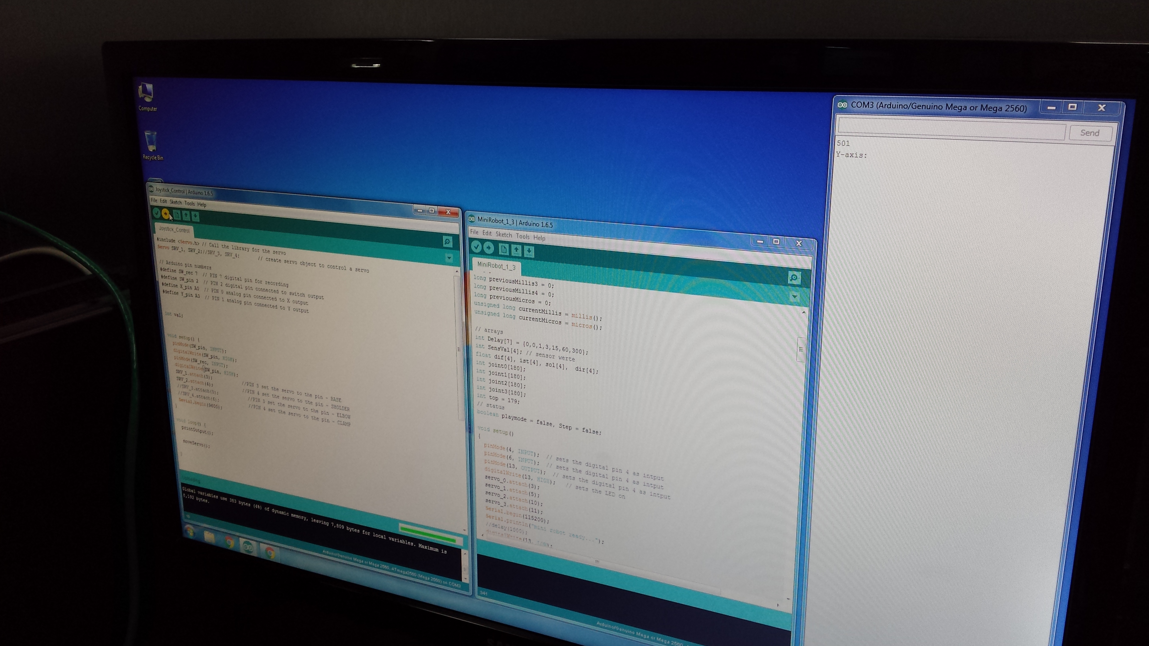
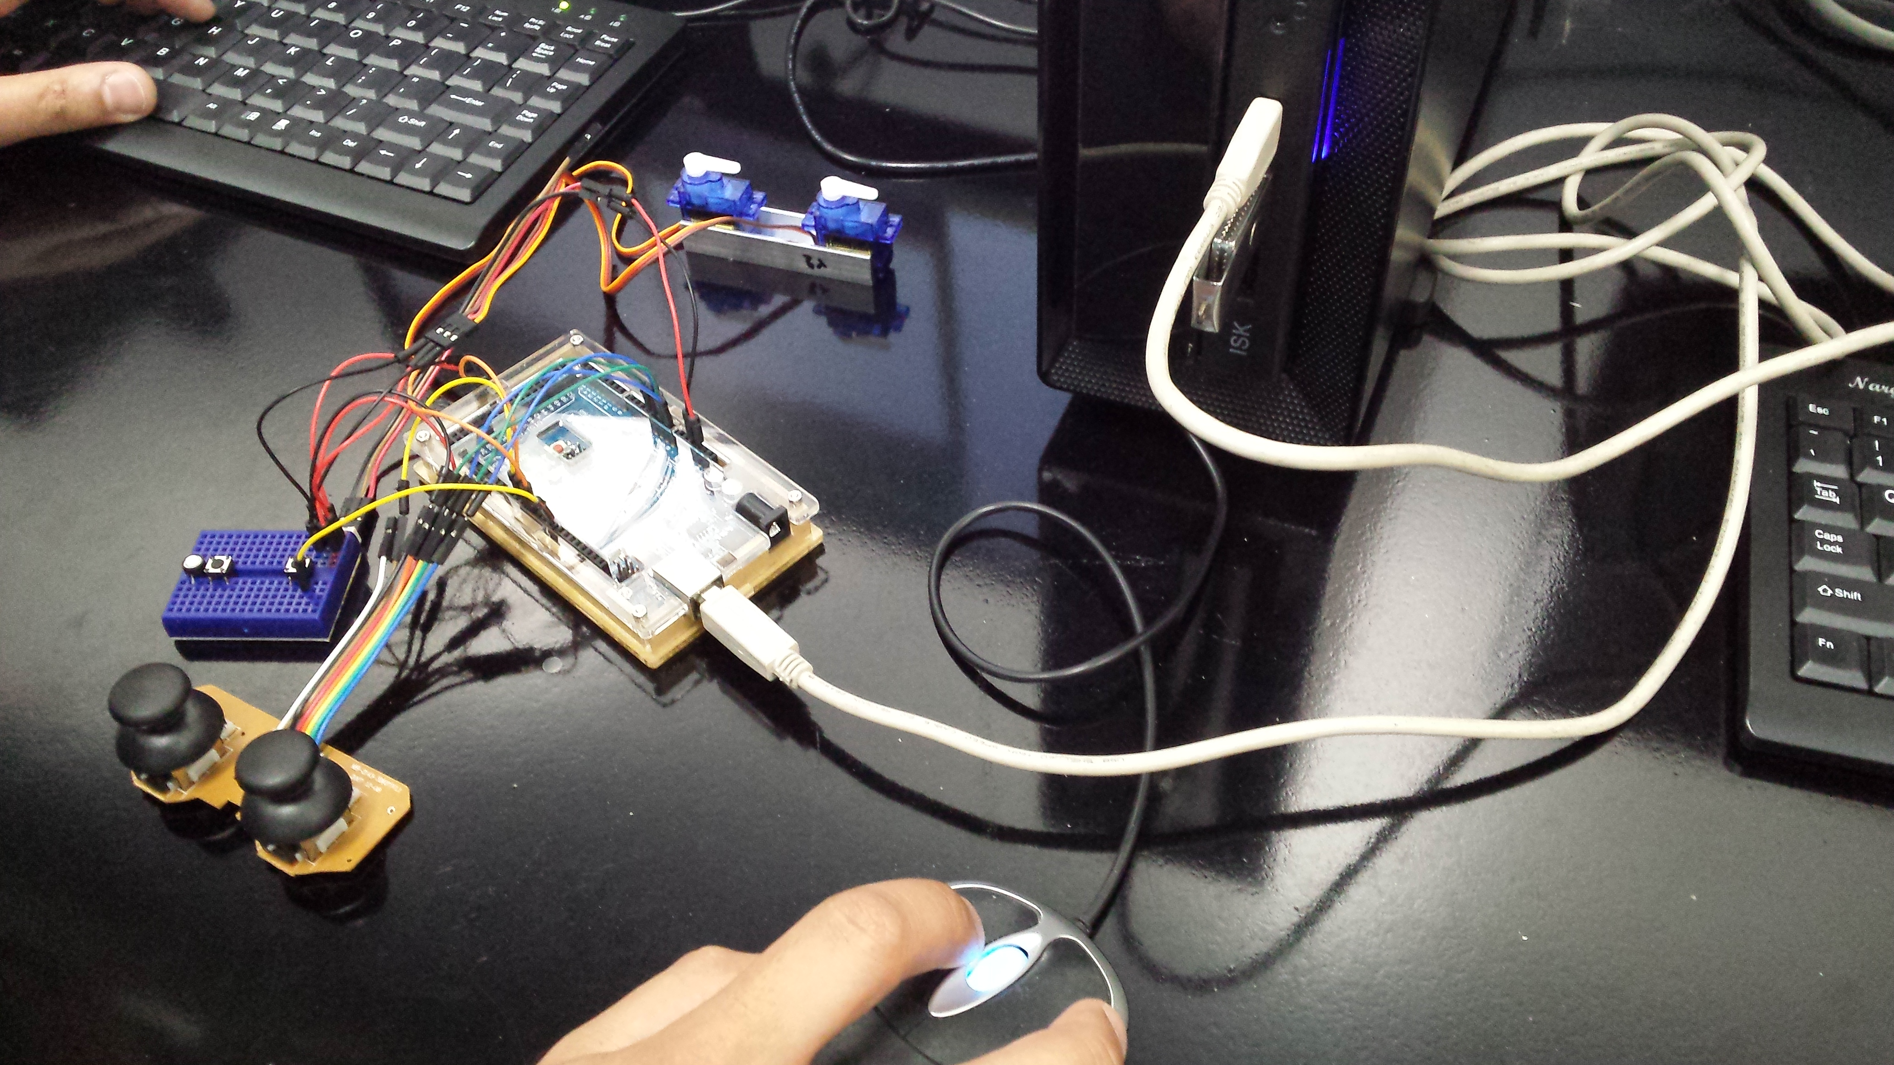
5. Some real world EV3 robot made in IT Lab

Slide 13
6. Build your own EV3 robot
Lego Mindstorms offers a vast number of EV3 robot that comes with extension pack and that help you to build your own choice of robot. You can chose and design a serial number of robot from transformer to wall-e, from snake to war tank. They all come with user manual and design guide. Once the robot is done we can go on Lego site and download EV3 Software for (PC/MAC) and start with our building block for EV3 robot.

Slide 14
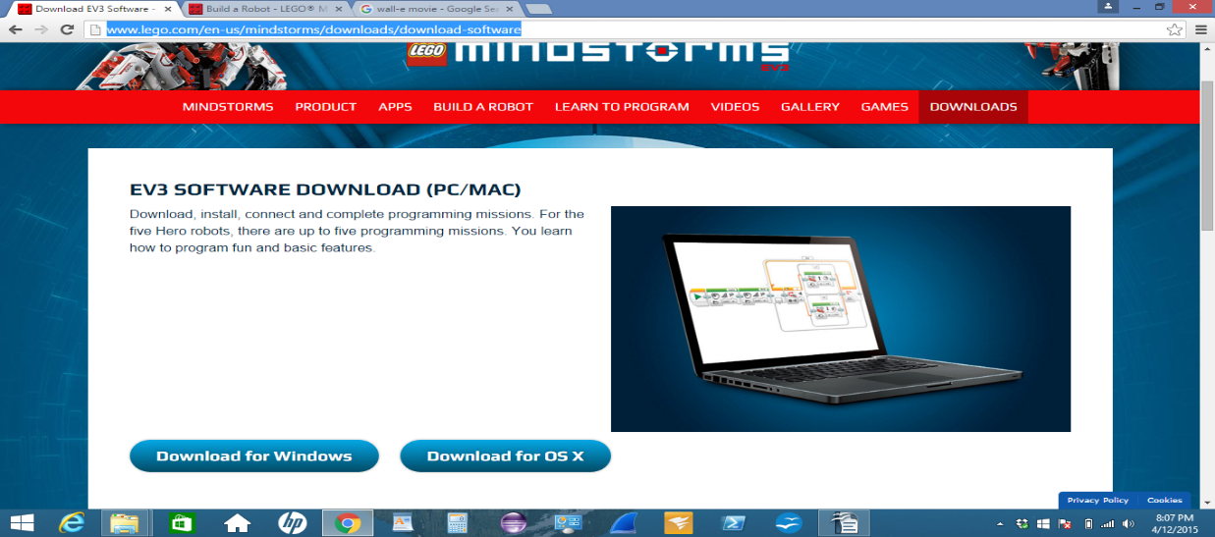
Download site- http://www.lego.com/en-us/mindstorms/downloads/download-software

Slide 15
7. Program with another language.
In this chapter we are going to discuss about some more interesting and deep things than we can do with our robot. Program your robot with another language. In this chapter we will know how to setup and give some hardcore command to our robot to follow instruction. In real world we will see that most of the robotics console or gaming platform dominating by C, C++, Java, C# language. Java is a widely known object oriented language that runs more than three billion devices. Java is a cross platform and powerful language that helps you to better understanding of objective and C language ground with less complexity. This java can also run our EV3 robot.

Slide 16
8. Introduce to Java leJos (Step-by-Step)
In this discussion we will disclose about a platform that allows our java code to execute in our real physical EV3 robotic device. To do this we need to follow some procedure step by step and accurately.

Slide 17
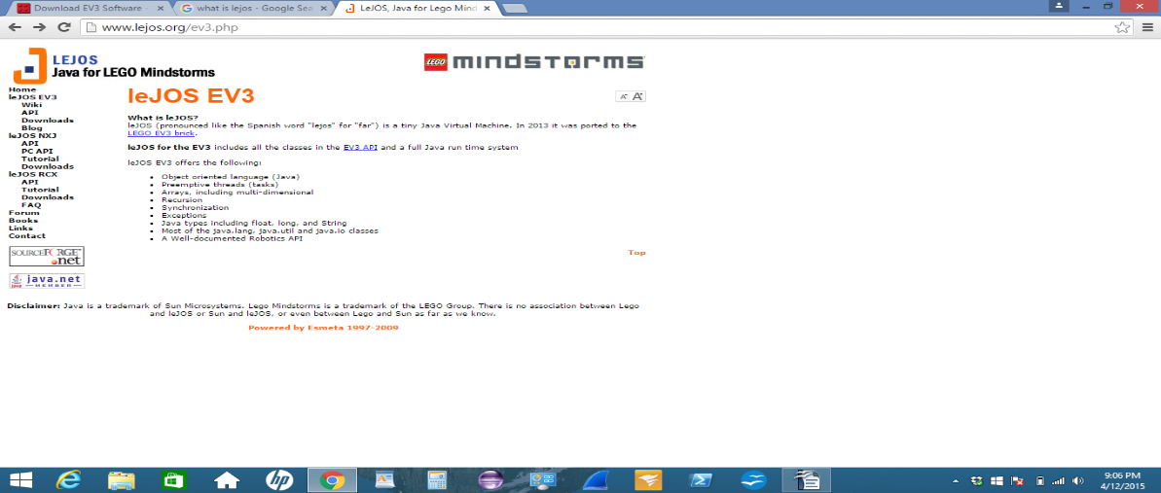
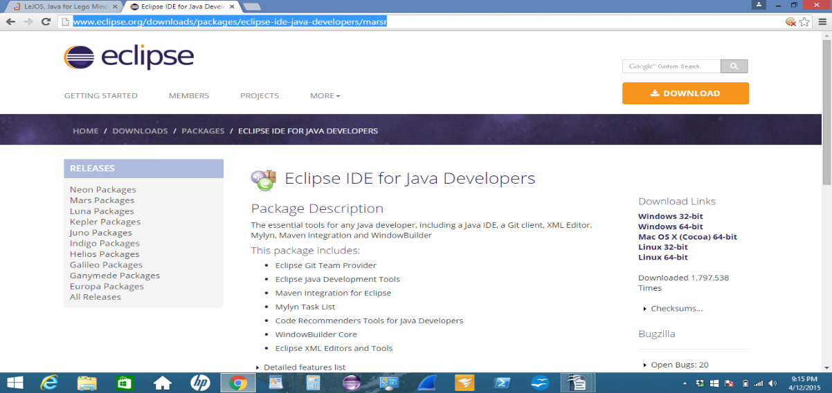
Step 1- Read this website http://www.lejos.org/ev3.php Step 2- Download eclipse http://www.eclipse.org/downloads/packages/eclipse-ide-java-developers/marsr

Slide 18
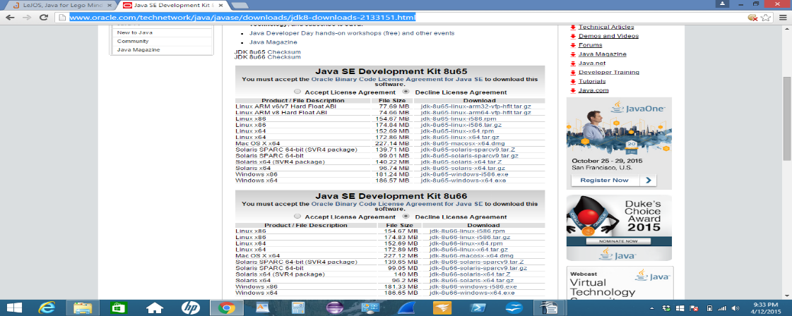
Step 3- Download JDK (java development kit) for your preferable operating system http://www.oracle.com/technetwork/java/javase/downloads/jdk8-downloads-2133151.html

Slide 19
Step 4- Get a micro sd card
Step 5- Download FAT32 GUI format to format your micro sd card
http://fat32-format.en.softonic.com
Step 6- Insert your micro sd card into your pc and format it with FAT32

Slide 20
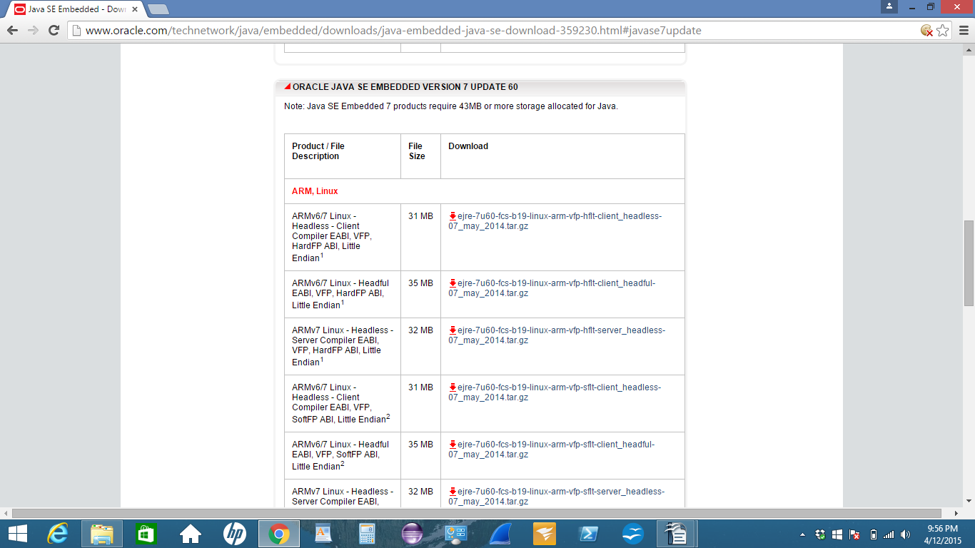
Step 7- Download JRE (java runtime environment) for EV3 robot. Make sure you download JRE 7 version because EV3 robot doesn't run on JRE 8 version. http://www.oracle.com/technetwork/java/embedded/downloads/java-embedded-java-se-download-359230.html#javase7update Download this- ejre-7u60-fcs-b19-linux-arm-sflt-headless-07_may_2014

Slide 21
Step 8- Download a firmware replacement call "leJOS" for EV3 robot, programable bricks
http://www.mirrorservice.org/sites/downloads.sourceforge.net/l/le/lejos/lejos-EV3/0.9.0-beta/
Download this- leJOS_EV3_0.9.0-beta_win32_setup

Slide 22
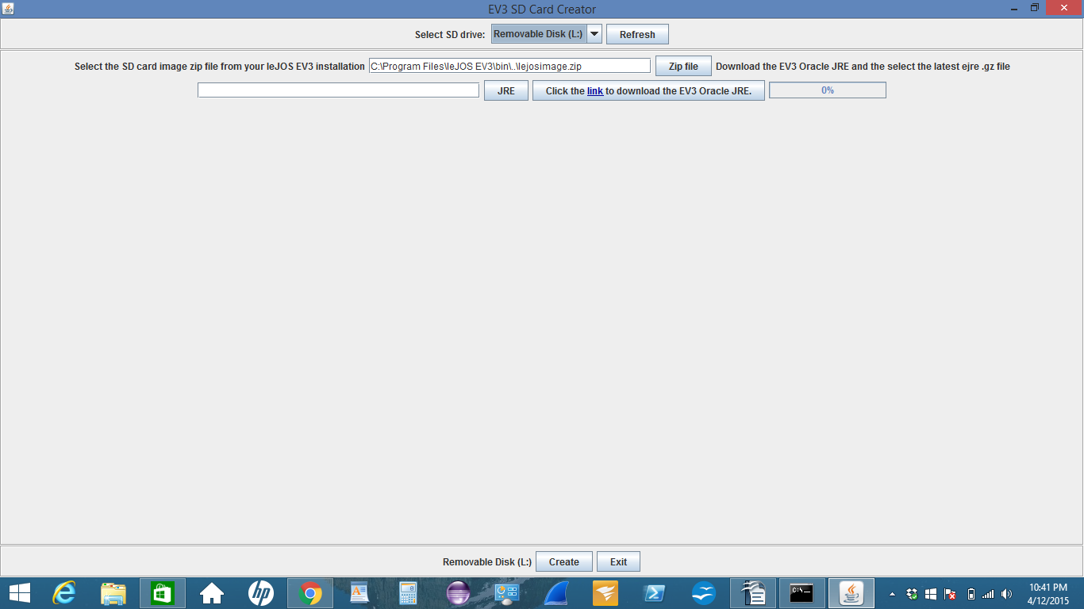
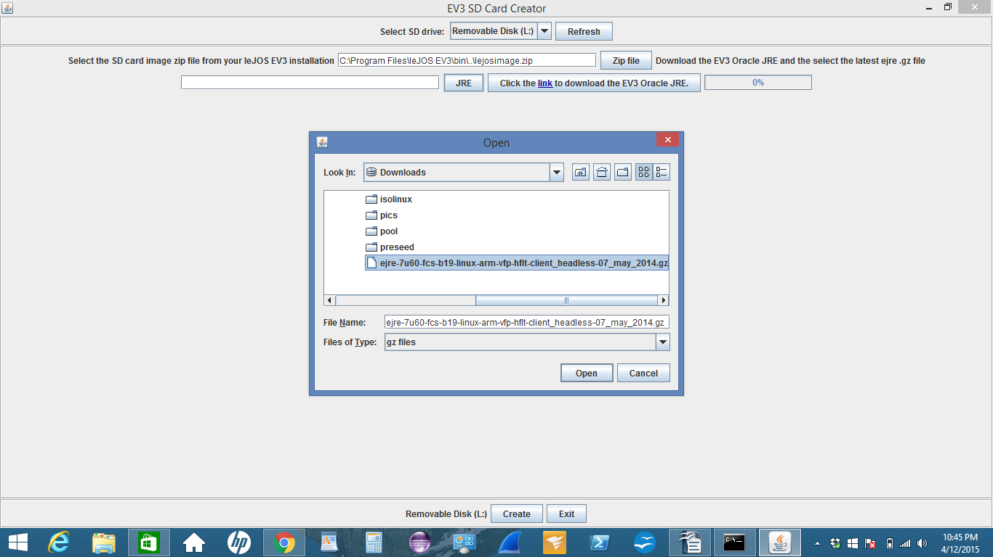
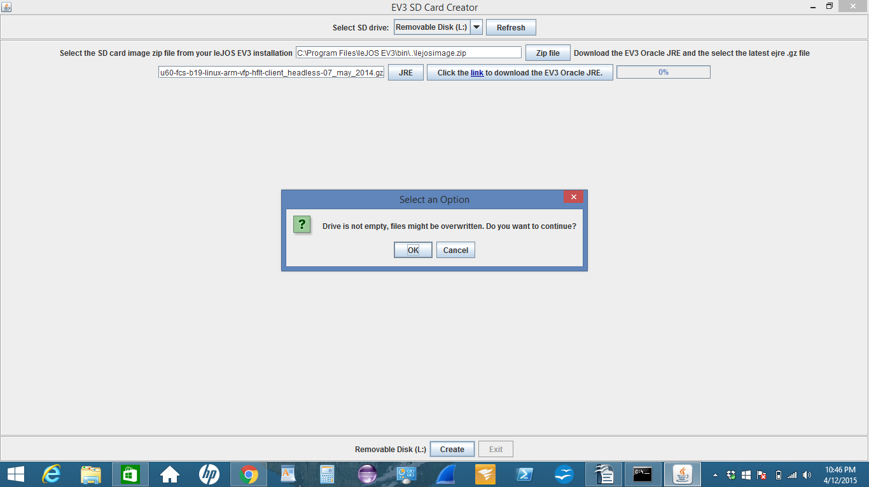
Step 9- Insert your micro sd card again into your pc and run leJOS firmware. Once the window is popup, create your sd card with this by first selecting JRE file you downloaded in step-7 and then second select create sd card.

Slide 23
Step 10- After creating our micro sd card for "leJOS", now we Insert our micro sd card into EV3 brick and plugin the brick to pc with provided usb cable.
Turn on the brick and wait for about 10 minutes for installing leJOS into the EV# robot brick.

Slide 24
Step 11- Now we make a connection between leJOS, eclipse and EV3 robot. To do this we need
to add a repository URL to our eclipse. Add this URL-
http://lejos.sourceforge.net/tools/eclipse/plugin/ev3
Now open eclipse first.(make sure you create a folder and name it "workspace" in C\Program Files if asked by eclipse or in case you can not open eclipse at first).
Once eclipse is open we will go to
Help -> Install New Software -> Add -> Location -> http://lejos.sourceforge.net/tools/eclipse/plugin/ev3 -> Ok -> Select All -> finish

Slide 25
Step 12- Now we will open a new lejos project with java class where we can write our java code for EV3 robot. To do this we need to go
File -> New -> Other -> leJOS project -> and create our new leJOS project
Then we go to package explorer on the left hand site of eclipse.
Right click our project -> New -> Class -> and we create our first java class for leJOS project.

Slide 26
9. Write your first EV3 java program
leJOS is a Java Virtual Machine (JVM) that allow your computer to run java program for your EV3 robot. leJOS comes with including 25 package and in those package hierarchies, there are hundreds classes. They can enable your robot to do any certain action you choose.
Java program for forwarding your EV3 robot :
In Eclipse, got to "leJOS EV3 Project" create a project and name it "EV3 Robot" (an example)
In "EV3 Robot" Project, create an package and name it "Pack" (an example).
In "Pack" , create a java class and name it "Robot Forward" (an example)

Slide 27
First program (move forword or backword)
package Pack;
import lejos.hardware.motor.Motor;
import lejos.utility.Delay;
public class RobotForward {
public static void main (String[]args){
Motor.A.forward();
Mototr.B.forward();
Delay.msDelay(5000);
Motor.A.stop();
Motor.B.stop();
}
}

Slide 28
In this java program we import leJOS hardware and utility package (remember that once you start coding your program, compiler will ask to import those class libraries so you just select and click. No need to import before you start programming. Easy )
Line: public class RobotForward //This is the line of our main class of "RobotForword". Every java program must contain a main class. Inside this main class we can have many sub classes that link together with main class.

Slide 29
Line: public static void main (String[]args) // This is the line of main method begin (word "main"). In java program you can have many method around our many classes but you will have to have a main method that will execute the entire program.(main is a special method that most of the time automatically called by java virtual machine but in many cases like EV3, we need to declare) The method declaration began with keyword "public" to indicate that "the method is available to public". It can be called from method from other classes. "public and "private" are access modifier. Next word is "static" means that, same like "public" word it allows to call a method before you created the method object. Next word is "void" which specifies the method return type. Here "void" means it will not return any kind of data after method completing its task. In this main method we can see that it is an argument and data type is String.

Slide 30
Line: Motor.A.forward(); // In this line we set the action for our EV3 robot. In this case we have 2 motor connected with 2 port A and B (EV3 brick has 8 port). So here word "Motor" means our EV3 motor. After this we write "." which means connect. Then we write word "A" means our EV3 port name (written on EV3 bricks). Then "." connect again. Now we write word "forward" means it will push our EV3 robot forward. Then "()" means it is a default constructor without any argument or value. We need this default empty parenthesis to execute java program. Next is ";" means end of one statement or line of code.
Line: Mototr.B.forward(); // Same as above line. The only difference here is the port name. This tome we are using Port "B" for our second EV3 motor.
Line: Delay.msDelay(5000); // This is the line decides about the time that how long we want to move our robot forward. We write 5000 milli second means 5 second. Once Motor A and B on move to forward, they will read this line and move forward for 5 seconds. Then execute the next line we have written.

Slide 31
Line: Motor.A.stop(); // After moving forward for 5 second we want stop our robot(otherwise it will move forever until charge is finished). Same like before we write "Motor", and ".", and "A", and ".", and "stop", and "()", and ";" means we connect Motor A to stop. End os statement.
Line: Motor.B.stop(); // Same like Motor A, here we are writing code for Motor B.
} // end of "main" method
} // end of main class "RobotForward"
Remember: In this program if you replace word "backward" instead of word "forward", robot will function same way as before. The only difference is now is that, this robot will move backward.

Slide 32
Second Program (turn 90 degree )
package Pack;
import lejos.hardware.motor.Motor;
import lejos.robotics.navigation.DifferentialPilot;
public class RobotTurn {
public static void main (String[]args){
new RobotTurn();
}
public RobotTurn (){
DifferentialPilot robot = new DifferentialPilot (1.2f, 4.1f, Motor.A, Motor.B);
robot.travel(12); //12 inch
robot.rotate(90); // rotate 90 degree
}
}

Slide 33
Line- new RobotTurn(); // here we create a constructor of main class "RobotTurn" means that we have created an object of main class " RobotTurn" so we can call this main class at any place of our program as an object of class.
Line- DifferentialPilot robot = new DifferentialPilot (2.1f, 4.1f, Motor.A, Motor.B); // here we call our class DifferentialPilot to do our main job. We create new object (instance) for DifferentialPilot and name it as "robot". Then inside the parenthesis we give the argument value as "1.6f (inch and floating value)" is our robot wheel diameter, then "4.1f" is our robot wheel distance, then two motor and their port number.

Slide 34
Third program (touch sensor and bumpercar) [ program (a) touch sensor ]
import lejos.robotics.SampleProvider;
import lejos.robotics.filter.AbstractFilter;
public class robo_touchSensor extends AbstractFilter {
float [] sample;
public robo_touchSensor(SampleProvider source) {
super(source);
sample = new float[sampleSize];
}
public boolean press(){
super.fetchSample(sample, 0);
if (sample[0] == 0){
return false;
}else{
return true;
} } }

Slide 35
Remember- program (a) and program (b) are two separate java class in same package but the work together. That is why program (a) is the child java class without "main" method. program (b) is the parent java class with "main" method.
Line- public class robo_touchSensor extends Abstract Filter // this line gives us a result of whether it is true or false means did we touch sensor or we did not touch sensor? if we touch the sensor this line will give us a true result and if we don't touch, it will give us a false result.
Line- float [] sample; // this line we created to declare our global variable to store date. global variable always set right after class declaration. (above all other thing)
Line - sample = new float[sample Size]; // here we setup (create object) our global variable declared before. [] bracket means we give the size of storage.
Line- super(source);// this line by default calling the supper class constructor
Line - public Boolean press(){ // we set our sensor detection method means touch sensor is pressed or not
Line - super.fetchSample(sample, 0); // this line will query for the true and false result.
Line - if (sample[0] == 0){ // this line here putting an if statement about our array "sample". if touch sensor pressed then true otherwise false.

Slide 36

[ program (b) bumpercar ]
import java.util.Random;
import lejos.hardware.Brick;
import lejos.hardware.BrickFinder;
import lejos.hardware.Button;
import lejos.hardware.motor.Motor;
import lejos.hardware.port.Port;
import lejos.hardware.sensor.EV3TouchSensor;
import lejos.robotics.navigation.DifferentialPilot;
import lejos.utility.Delay;

Slide 37
public class robo_bumperCar {
DifferentialPilot pilot;
Random ran;
robo_touchSensor touch;
public static void main(String[] args) {
new robo_bumperCar();
}
public robo_bumperCar(){
pilot = new DifferentialPilot(2.1f, 4.1, Motor.B, Motor.C);
ran = new Random();

Slide 38
Brick brick = BrickFinder.getDefault();
Port s1 = brick.getPort("S1");
Port s2 = brick.getPort("S2");
EV3TouchSensor sensor = new EV3TouchSensor(s1);
EV3TouchSensor sensor2 = new EV3TouchSensor(s2);
touch = new robo_touchSensor(sensor);
touch = new robo_touchSensor(sensor2);

Slide 39
pilot.forward();
while(true){
Delay.msDelay(2);
if (touch.press()){
pilot.stop();
pilot.travel(-6);
if(ran.nextBoolean()){
pilot.rotate(90);
}else{
pilot.rotate(-90);
}
pilot.forward(); }

Slide 40
if(Button.ESCAPE.isDown()){
pilot.stop();
sensor.close();
sensor2.close();
System.exit(0);
}
}
}
}

Slide 41
Line - DifferentialPilot pilot; // Random ran; // robo_touchSensor touch; //
These three line our global variable
Line - new robo_bumperCar(); // constructor of main class
Line- DifferentialPilot pilot = new DifferentialPilot (2.1f, 4.1f, Motor.A, Motor.B);
// here we call our class DifferentialPilot to do our main job. We create new object (instance) for DifferentialPilot and name it as "pilot". Then inside the parenthesis we give the argument value as "1.6f (inch and floating value)" is our robot wheel diameter, then "4.1f" is our robot wheel distance, then two motor and their port number.

Slide 42
Line - ran = new Random(); // create new Random object "ran"
Line - Brick brick = BrickFinder.getDefault(); // this line will find the brick of ev3 robot and create an object of it. here "brick" is the object of class "Brick"
Line - Port s1 = brick.getPort("S1"); // Port s2 = brick.getPort("S2"); //
//these two line will create the port to use the brick via port number.
Line - EV3TouchSensor sensor = new EV3TouchSensor(s1); // EV3TouchSensor sensor2 = new EV3TouchSensor(s2);
//these two line create the real touch sensor object and pasing pazssing it to port connected to ev3 brick

Slide 43
Line - touch = new robo_touchSensor(sensor); // touch = new robo_touchSensor(sensor2);
//these two line create object of our java class "robo_touchSensor"
Line - next all those line are if statement and they validating true or false state of our ev3 robot.

Slide 44
10. Conclusion
EV3 Emergency Shutdown - EV3 will crash many times during the experiment. We need to know the basic button function. EV3 has all together 6 buttons. Button "centre", "left", "right", "top" and "bottom" are together. Button "back" is separately sitting on your top left side. With this "back" button we can always go back to the previous screen. In emergency shutdown we need to press "back", "left" and "centre" button together. When screen goes black, release "back" button. When says starting, release "left" and "centre" button.
Glider man's Channel - Everybody must watch, follow, comment and question here https://www.youtube.com/watch?v=5RS88vYtErE&list=PL3c9v1f7NWPPxYvbvedCeXzKvqBciiTFn
EV3 API - Learn about EV3 package, class and their function http://www.lejos.org/ev3/docs/

